Slide 1
AVERAGE EFFECT
Mean centred beat perception covariate
19 subjects

Slide 2
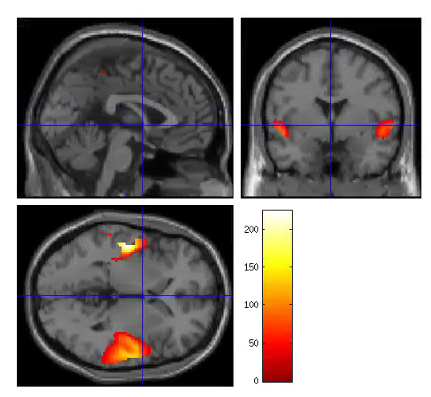
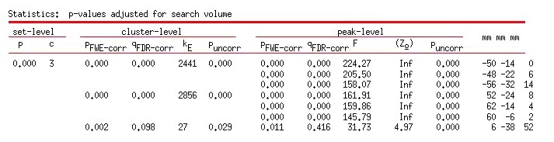
S1TBL_beatper_mean_19subj
Extent threshold = 19
P<0.05 FWE cor
ROI1
ROI2

Slide 3
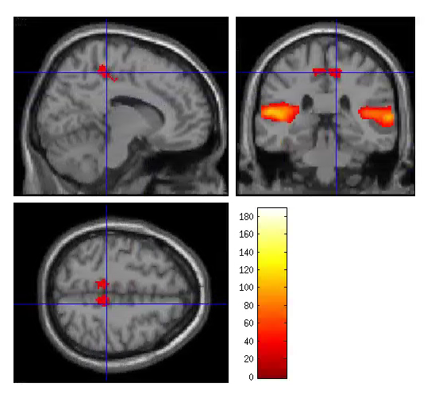
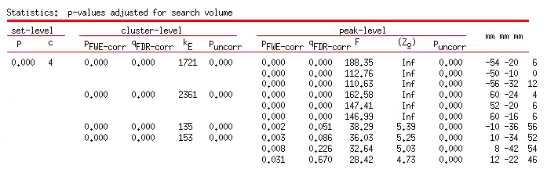
S2TBL_beatper_mean_19subj
Extent threshold = 20
P<0.05 FWE cor
Sig effect of beat perception in ROI3 and 4
ROI1
ROI2
ROI3
ROI4

